Slide 1
Lab 6 Array
Dr : Ghada
Eng : Gehad Mustafa
Eng : Somaya

Slide 2
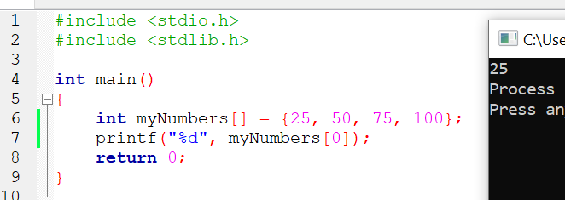
Access the Elements of an Array

Slide 3
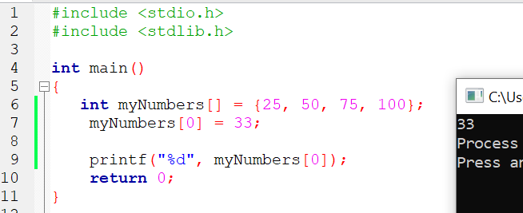
Change an Array Element

Slide 4
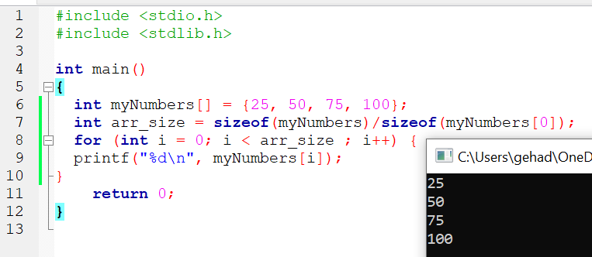
Loop Through an Array

Slide 5
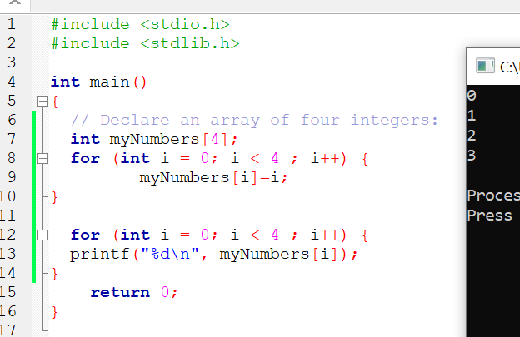
Set Array Size

Slide 6
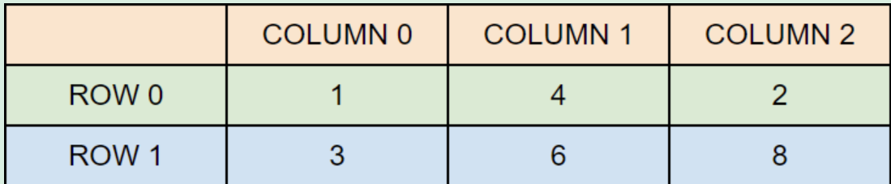
Multidimensional Arrays
int matrix[2][3] = { {1, 4, 2}, {3, 6, 8} };

Slide 7
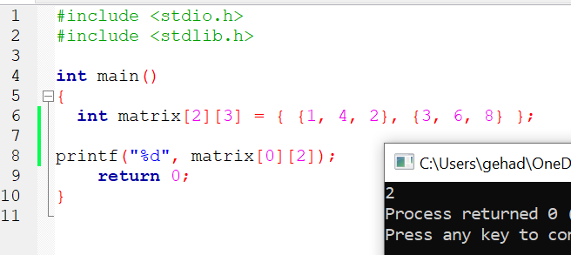
Access the Elements of a 2D Array

Slide 8
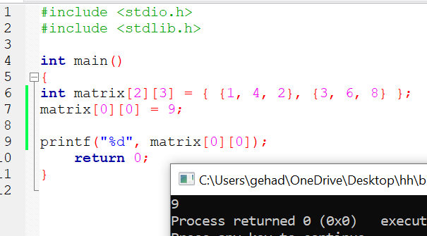
Change Elements in a 2D Array

Slide 9
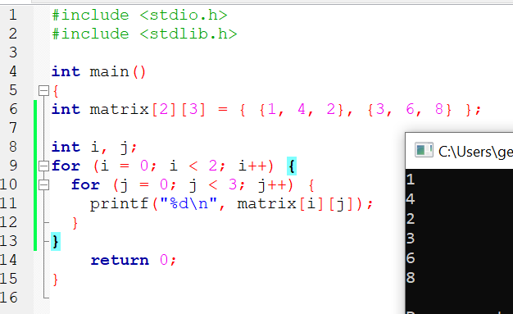
Loop Through a 2D Array

Slide 10
Try
Try to print the average of 1-d entered array.
Try to print the sum of even and sum of odd numbers in 1-d entered array.
Try to double all the elements of the matrix.
Try to print the row sum and column sum of a matrix.

Slide 11
